Slide 1


The Invisible Warrior
A Native American Story
Retold by Lin Donn
Illustrated by Phillip Martin

Slide 2

The Invisible Warrior
A Native American Story
Native Americans taught good behavior by using stories, myths, and legends to make a point.
This story, based on an Eastern Woodland Indian folk tale, shows that although a similar folk tale can appear in many cultures, each reflects the culture in which it appears.

Slide 3

The Invisible Warrior
Once upon a time, a long time ago, there lived a great warrior. The people told many stories about this strange and wondrous warrior.
One story said that this magical warrior could make himself invisible. That meant he could wander among the enemies of the tribe, and hear all of their war plans.

Slide 4
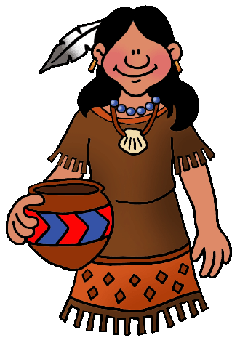
The Invisible Warrior
Another story told of his great loneliness.
The only person who could see the invisible warrior was his sister. As much as he loved her, he longed for a wife.
The invisible warrior wanted a wife who was gentle and truthful. He vowed he would not marry until he found a maiden, someone besides his sister, who could truly see him.

Slide 5

The Invisible Warrior
He used a trick to weed out the liars. He had his sister lead each maiden towards him as he headed home, pulling his sled.
As instructed, his sister asked each maiden if she could see the invisible warrior. Oh yes, nearly all replied. And what is he pulling? His sled they answered. Everyone knew that!

Slide 6
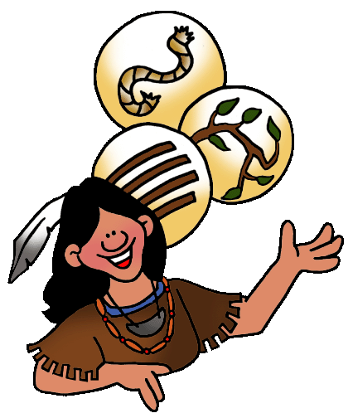
The Invisible Warrior
How is the sled tied she would ask? Here the answers varied. One said with strong rope. Another said with strong vines. Still another said with strong leather.
Since none of these answers was correct, the invisible warrior knew that each maiden had lied.

Slide 7
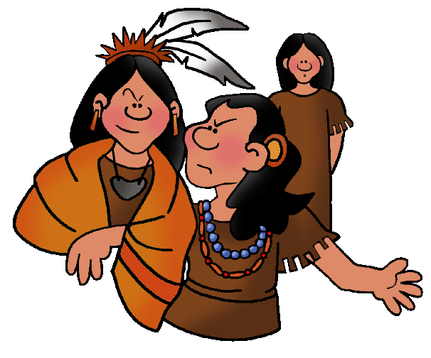
The Invisible Warrior
Maiden after maiden attempted to marry the famous warrior, but none passed the test.
The invisible warrior thought about talking to the chief. The chief had three daughters. Perhaps he could marry one of them.
But the warrior had heard that the three sisters were mean.

Slide 8
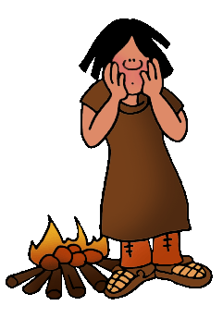
The Invisible Warrior
Truthfully, the two oldest sisters were as cruel as the warrior had heard.
The youngest, however, was kind and gentle.
Jealous of her beauty, her sisters rubbed her face with hot coals, scarring her face. They cut her long hair. They made her do all the work, theirs as well as her own. If she refused, they told lies about her to their father. The youngest was too gentle, and perhaps too afraid, to complain.

Slide 9

The Invisible Warrior
Now, although the invisible warrior did not wish to marry any of the chief’s daughters, they all wanted to marry him. He was a warrior and magical besides.
The two oldest sisters came
to the meeting place. One said his sled was tied with a strong braid of human hair. The other said it was tied with mighty branches. Since neither answer was correct, the warrior, with great relief, sent both girls back to their father.

Slide 10
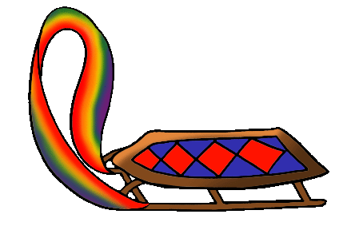
The Invisible Warrior
When her work was done for the day, the youngest sister also came to the meeting place, just as the sun was setting. When asked how his sled was tied, her face lit with pleasure. “With a rainbow,” she answered softly.
Only the invisible warrior could see what he used to pull his sled. It may not, after all, have been a rainbow. But he had looked into the heart of the youngest daughter. With joy, he
knew he had found his maiden at last.

Slide 11
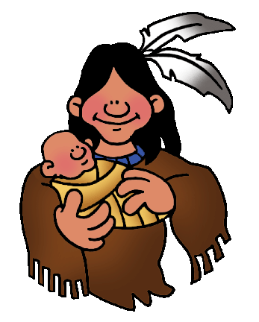
The Invisible Warrior
He asked her to take her seat in his tent and be his wife.
As time passed, the chief’s youngest daughter gave birth to a strong son. Her hair grew long. Her scars disappeared. Her life was full and happy.

Slide 12
The Invisible Warrior
To her, the warrior was not invisible. As everyone could see, if they simply looked, her warrior was the most wonderful man in the world!
The invisible warrior and his wife lived happily together for the rest of their lives.

Slide 13
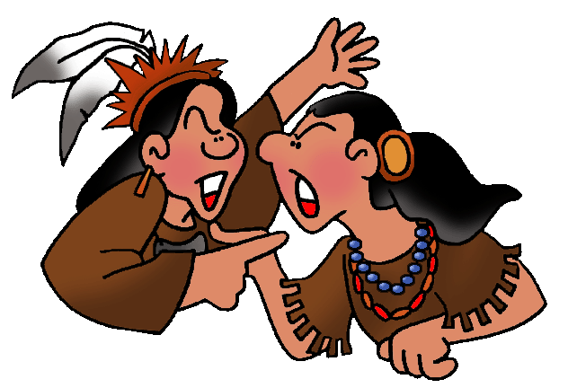
The Invisible Warrior
As for the two ugly sisters, they lived together in a tent of their own making – unmarried, unloved, and ignored. As the years went on, many stories were told of the ugly sisters.
When maidens heard the stories, they vowed never to be mean again.
Question: What fairy tale does this story remind you of?

Slide 14
To Learn More
Did you answer “Cinderella”? We thought so, too!
To read more Cinderella stories, go here: Cinderella Stories From Around the World
To learn more about Native Americans - go here: Native Americans

Slide 15
FREE Clip Art & Templates
To find FREE clip art & FREE templates you can use to dress up web pages and school reports, created by a professional and published artist, Phillip Martin, go here:
Native American Clip Art
Free Templates

Slide 16

Explore …
PPPST.COM

